Slide 1
MERN STACK

Slide 2
We need to code to develop a WEB APP
For this we Require
HTML5,JAVASCRIPT AND CSS

Slide 3
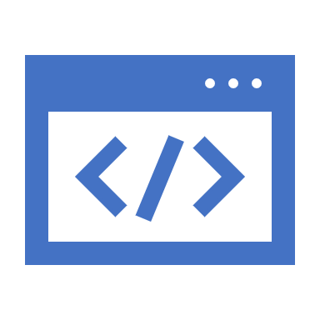
Coding Languages?
When you’re designing or developing a website, there are three different coding languages that you will want to be aware of: HTML, CSS, and JavaScript.

Slide 4
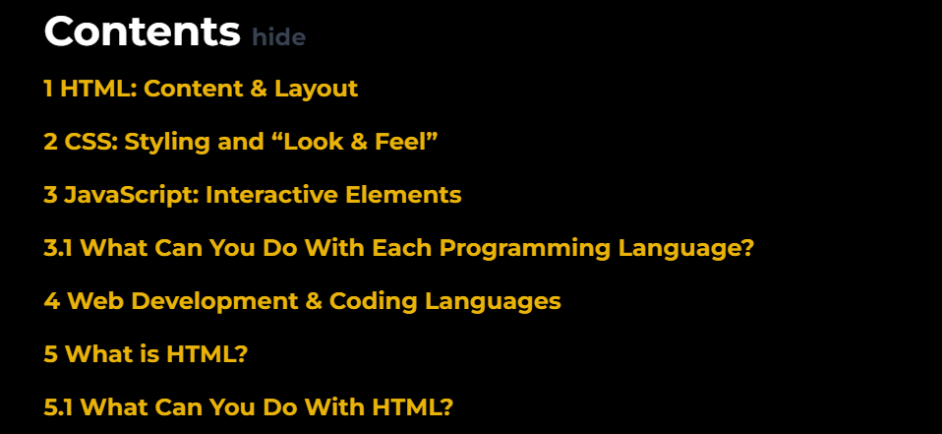

Slide 5
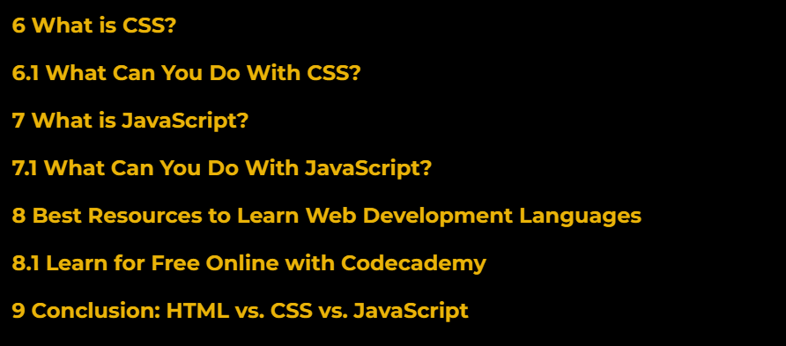

Slide 6
HTML: Content & Layout
HTML is a language that determines how documents and web pages are displayed in a web browser, the language for the building blocks of any website.

Slide 7
CSS: Styling and “Look & Feel”
CSS (Cascading Style Sheets) is a popular style sheet language that determines how a document created in HTML is styled (colors, font styles, layout and responsive features).

Slide 8
JavaScript: Interactive Elements
JavaScript allows you to change CSS and HTML elements on your website after the site has been loaded, which gives you the ability to make your site more interactive and engaging for users.

Slide 9
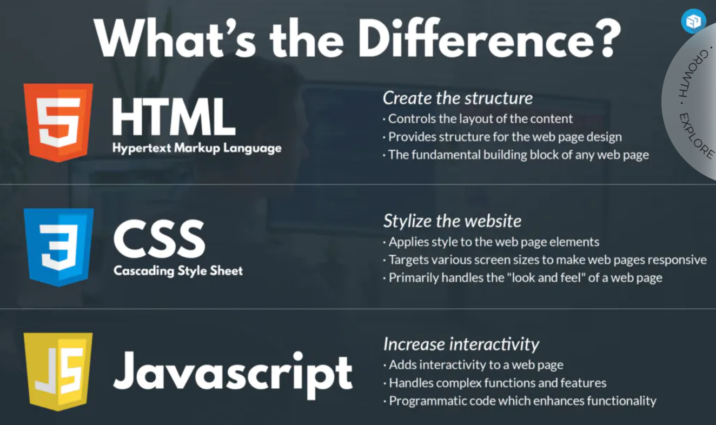

Slide 10
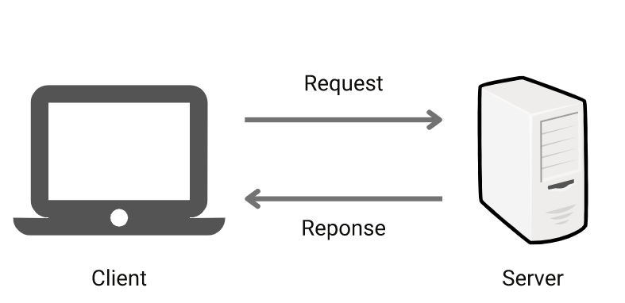
Client Server Architecture in System Design

Slide 11
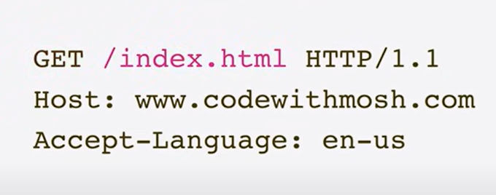
Basic Request Headers

Slide 12
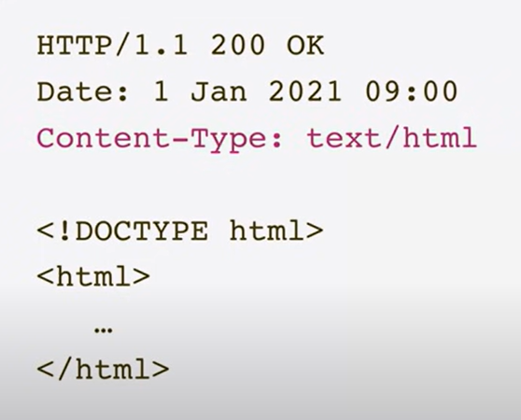
Basic Response

Slide 13
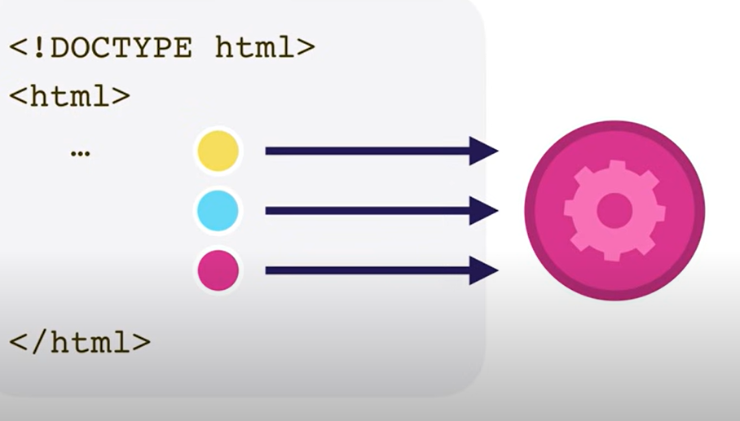
Different URLS for Same Domian

Slide 14
Required Softwares
1) Visual Studio Code – Good Editor
2) Notepad++
3) NodeJs
4) GIT

Slide 15
Queries?
If you have any queries please whatsapp on :6304353162

